Slide 1
Government College of Engineering, Karad Mini Project – Review I Fruit Disease Detection using Image Processing Guided by: Prof. N. M. Mule Team Members : Rani Kamble Mohsina Mulani

Slide 2
Table Of content
Introduction
Motivation
Existing System
Literature Survey
Gap Identification
Conclusion

Slide 3
Introduction
Production rate reduces due to infected fruits.
Very difficult to monitor the diseases manually
This deep learning project used for detection of diseases with more accuracy
It is cost-effective and real-time solution to detect fruit diseases.

Slide 4
Motivation
India is an agrarian economy.
Agriculture shares 17% of the country’s GDP.
Increasing farm productivity is the need of the hour.
Annually more than one-third of the crop yield is affected by the diseases in India.
Fruit diseases can cause major losses in yield and quality appeared in harvesting.
.

Slide 5
Literature Survey
Research Work | Algorithm | Disadvantages | Problem Domain | Accuracy
Detection and Classification of Apple Fruit Diseases using Complete Local Binary Patterns [1] | SVM With K-Means | Does not perform very well when the data set has more noise | Detection and Classification | 93%
Disease Classification and Grading of Orange using Machine Learning and Fuzzy Logic [2] |  |  | Classification | 90%
Computer-Based Classification of Diseased Fruit using K-Means and Support Vector Machine [3] |  |  | Classification | 92%
Automatic Citrus Fruit Disease Detection by Phenotyping Using Machine Learning [4] | SVM | Not acceptable for large data sets | Classification | 88.96%
Table 1. Literature Survey

Slide 6
Literature Survey
Research Work | Algorithm | Disadvantages | Problem Domain | Accuracy
A Deep Neural Network-based disease detection scheme for Citrus fruits [5] | CNN | Training process takes a lot of time if the computer doesn’t consist of a good GPU | Detection | 89.1%
Disease Detection in Plum Using Convolutional Neural Network under True Field Conditions [6] |  |  | Classification | 92%
Detection of Strawberry Diseases Using a Convolutional Neural Network [7] |  |  | Detection | 99.60%
Table 2. Literature Survey

Slide 7
Literature Survey
Research Work | Algorithm | Disadvantages | Problem Domain | Accuracy
Automatic Citrus Fruit Disease Detection by Phenotyping Using Machine Learning [8] | ANN | Hardware dependence | Classification | 93.12%
Detection and Classification of Apple Fruit Diseases using K-means clustering and Learning Vector Quantization Neural Network.[9] | K-means clustering and Learning Vector Quantization Neural Network | Cannot handle outliers and noisy data | Detection and Classification | 95%
Table 3. Literature Survey

Slide 8
EXISTING SYSTEMS
Several models for fruit disease identification are:
ANN, decision tree, etc.
Major concerns for these models:
Slow and inefficient algorithm
Sensitive to location of objects
Hardware dependence
Not acceptable for large data sets
Does not perform very well when the data set has more noise

Slide 9
GAP IDENTIFICATION
Convolution:
Connections sparsity reduces overfitting
Convolution+ polling gives invariant feature detection
Parameter sharing
Relu:
Introduces nonlinearity
Speeds up training, faster to compute

Slide 10
GAP IDENTIFICATION
Pooling:
Reduces dimensions and computation
Reduces overfitting
Makes the model tolerant towards small distortions and variations

Slide 11
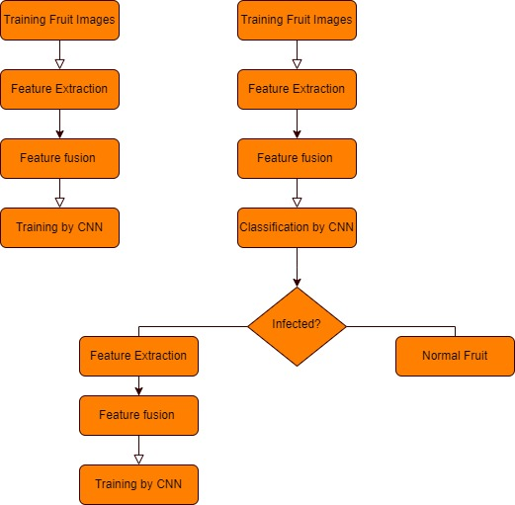
PROPOSED METHADOLOGY
Algorithm used: CNN
Fig.1 Flowchart

Slide 12
PROPOSED METHADOLOGY
Step by step process:
Uploading the image of the fruit by user
Using CNN Algorithm the image is resized according to the requirements and then Features are extracted from the image
Features like fruit name, shape, size and colour of the image is extracted. And then the image is added to the dataset for the future analysis
By using K-Means clustering the image is mapped to the related clusters by using feature extracted and then the disease will be identified
Finally, the status of the fruit is identified and it passed to user as output.

Slide 13
CONCLUSION
Segmentation is performed using k means clustering to optimise the result classification is handled using convolution neural network.
Convolution neural network mechanism takes the segmented image pixels as population and generates distinct results in terms of classification accuracy.
Result is compared against the previous result. This process continues until desired result is obtained.
The proposed system detects the type of disease with greater accuracy.
The disease is detected in a very cheap and fast way.

Slide 14
REFERENCES
S. R. Dubey and A. S. Jalal, "Detection and Classification of Apple Fruit Diseases Using Complete Local Binary Patterns," 2012 Third International Conference on Computer and Communication Technology, 2012, pp. 346-351, DOI: 10.1109/ICCCT.2012.76.
S. K. Behera, L. Jena, A. K. Rath, and P. K. Sethy, "Disease Classification and Grading of Orange Using Machine Learning and Fuzzy Logic," 2018 International Conference on Communication and Signal Processing (ICCSP), 2018, pp. 0678-0682, DOI: 10.1109/ICCSP.2018.8524415.
Bekkanti, V. S. R. K. P. Gunde, S. Ital, G. Parasa, and C. M. A. K. Z. Basha, "Computer-Based Classification of Diseased Fruit using K-Means and Support Vector Machine," 2020 Third International Conference on Smart Systems and Inventive Technology (ICSSIT), 2020, pp. 1227-1232, DOI: 10.1109/ICSSIT48917.2020.9214177.
Doh, D. Zhang, Y. Shen, F. Hussain, R. F. Doh and K. Ayepah, "Automatic Citrus Fruit Disease Detection by Phenotyping Using Machine Learning," 2019 25th International Conference on Automation and Computing (ICAC), 2019, pp. 1-5, DOI: 10.23919/IConAC.2019.8895102.

Slide 15
REFERENCES
V. Kukreja and P. Dhiman, "A Deep Neural Network based disease detection scheme for Citrus fruits," 2020 International Conference on Smart Electronics and Communication (ICOSEC), 2020, pp. 97-101, DOI: 10.1109/ICOSEC49089.2020.9215359.
Ahmad, J., Jan, B., Farman, H., Ahmad, W., & Ullah, A. (2020). Disease detection in plum using convolutional neural network under true field conditions. Sensors, 20(19), 5569. Doi: https://doi.org/10.3390/s20195569
Xiao, J. R., Chung, P. C., Wu, H. Y., Phan, Q. H., Yeh, J. L. A., & Hou, M. T. K. (2020). Detection of strawberry diseases using a convolutional neural network. Plants, 10(1), 31. https://doi.org/10.3390/plants10010031
Shafi, A. S. M., Rahman, M. B., & Rahman, M. M. (2018). Fruit disease recognition and automatic classification using MSVM with multiple features. Int J Comput Appl, 181(10), 0975-8887.
JMCOE, J. (2017). Detection and Classification of Apple Fruit Diseases using K-means clustering and Learning Vector Quantization Neural Network.
https://www.ijsdr.org/papers/IJSDR17060
M. Dhakate and Ingole A. B., "Diagnosis of pomegranate plant diseases using neural network," 2015 Fifth National Conference on Computer Vision, Pattern Recognition, Image Processing and Graphics (NCVPRIPG), 2015, pp. 1-4, DOI: 10.1109/NCVPRIPG.2015.7490056.

Slide 16
Thank You!

